Slide 1
K-12: Transitioning from ACSIP to INDISTAR
Title I Department: Little Rock School District
Supplemental Training Module

Slide 2
Model Best Practices during Training
Use video or other media to direct participant’s focus as they enter the room. Indistar has a variety of materials that are easy to access and use immediately.

Slide 3
Look for this Title for additional training opportunities.
As we transition from the ACSIP website to the INDISTAR process, we will provide opportunities for you and your staff to experience more of INDISTAR throughout this transitional year. All of the professional learning opportunities will have this title along with a subtitle such as Phase I, II or III. We will implement Indistar in cycles.

Slide 4
Presentation Agenda
The ACSIP/Indistar process encourages the use of agenda’s for all meetings and major activities that take place within your school. Agendas are an excellent piece of documentation/ evidence for reviewers.

Slide 5
Implementing Phase I: Separate Processes
In Phase I of the implementation process, we want to clearly separate the compliance requirements of the planning process from the school improvement process. Phase I of the implementation process ends on October 1, 2015.

Slide 6
2015-16 Use the ACSIP Field Test
As the ADE transitions from the ACSIP website as the planning tool for school and district improvement plans to the INDISTAR process, all schools/districts in the state will use the ACSIP STATEWIDE FIELD TEST portal in INDISTAR for compliance and planning.

Slide 7
Home Page: Resources
There are five (5) training modules on the INDISTAR Home Page that are critical for understanding this new process. You may choose to view them in your Leadership Team meetings to determine when and/how to share/implement each phase of the INDISTAR process with your staff.

Slide 8
Technical Assistance
By October 1, All compliance documentation must be submitted to the Arkansas department of Education. The LRSD Title I Department will provide a series of Technical Assistance workshops for school teams beginning August 31st.

Slide 9
Accessing Indistar
By now, all schools should have Access to the Indistar website.
Please protect your school’s login and password. Your school community may access the Indistar website using the guest pass.

Slide 10
Examine the Test Site
if you would like to “look around” or “play” with the Indistar website before working in your school’s site, login as “arschool” . The Password is also “arschool”. This is a test site that you may use to become more familiar with Indistar.

Slide 11
Phase I: Required Forms
Our primary focus for the first phase of implementing the statewide field test (Indistar) is the completion of the required forms and Budgets. Review the forms in the second tab “Complete Forms”.

Slide 12
Required Forms
All schools will complete the supplemental compliance report on or before 10-1-2015.
All schools will complete the state categorical program general description on or before 10-1-2015.
ONLY TITLE I schools Are required complete the SCHOOLWIDE PLAN rubric FOR MONITORING AND Evaluation on or before 10-1-2015.

Slide 13
Required Forms
All schools will complete the supplemental compliance report on or before 10-1-2015.

Slide 14
Required Forms for ALL Schools
Required for all schools
Save information as you go; submit once you have completed the form.
Important Info--Please read!!!!

Slide 15
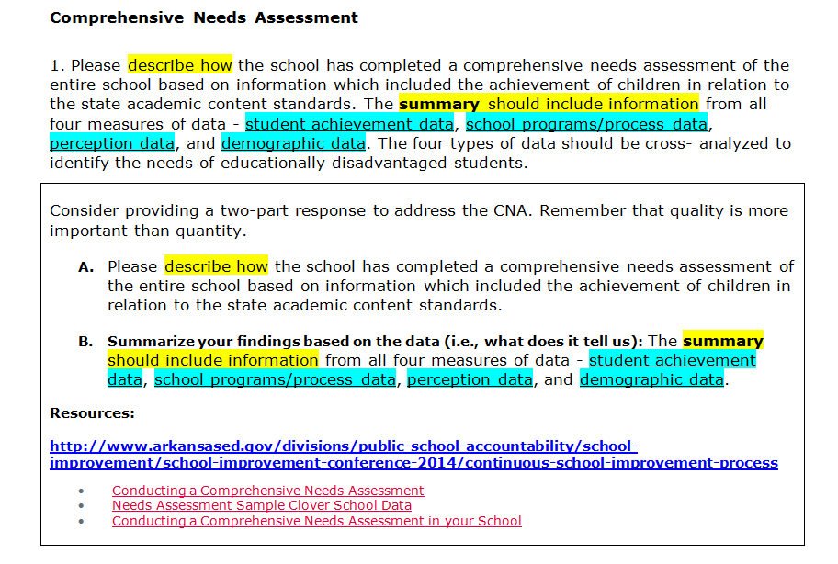
CNA
Fillable Text box—the program works better using “Notepad / rich text” if you want to cut and Paste from other documents.

Slide 16
Transition (Elementary)

Slide 17
Transition (Secondary)

Slide 18
Funding and Programs

Slide 19
Funding and Programs

Slide 20
Highly Qualified Staff

Slide 21
Health and Wellness
In addition to support from the following LRSD Departments (Child Nutrition and Health Services), the Resources below may also support your needs:
http://www.arkansased.gov/divisions/fiscal-and-administrative-services/child_nutrition_unit/important-information
http://www.fns.usda.gov/tn/local-school-wellness-policy
http://www.arkansased.gov/public/userfiles/rules/Current/ade_259_Physical_Activity_and_Nutrition_Standards_Rule_-_February_2012.pdf

Slide 22
Wellness Strategies

Slide 23
Wellness Strategies

Slide 24
School Health Index (SHI)
No additional information required for this item; just upload the requested document(s).

Slide 25
Required Forms
All schools will complete the state categorical program general description on or before 10-1-2015.

Slide 26
Categorical Funding

Slide 27
Categorical Funding Narratives

Slide 28
ALE Funding - Narrative
Schools having ALE Programs:
Washington
Henderson
McClellan

Slide 29
ELL Funding - Narrative
Schools using with ELL Programs and/or budgeting Ell Funds:
Henderson
Cloverdale
Baseline
Chicot
Watson

Slide 30
NSLA Funding - Narrative
All schools have
Programs and/or positions supported with NSLA Funds.

Slide 31
PD Funding - Narrative
Not
Required for Schools
District Level Only

Slide 32
Required Forms
ONLY TITLE I schools Are required complete the SCHOOLWIDE PLAN rubric FOR MONITORING AND Evaluation on or before 10-1-2015.

Slide 33
Rubric for Monitoring & Evaluation
What are the reform strategies
taking place in your school?
Need assistance
Determining your rating?

Slide 34
Rubric for Monitoring & Evaluation
You May want to review the Indicators associated with PD in Indistar.
Need assistance
Determining your rating?

Slide 35
Rubric for Monitoring & Evaluation
Need assistance
Determining your rating?

Slide 36
Rubric for Monitoring & Evaluation
Need assistance
Determining your rating?

Slide 37
Title I and Other Budgets

